Slide 1
Nuclear imaging – Basics & Role in CAD

Slide 2
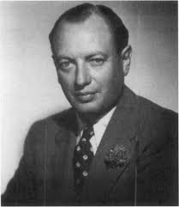
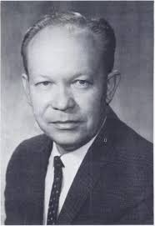
History
Helmann Blumgart
Myron Prinzmetal
Hal Anger

Slide 3
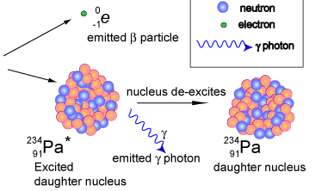
Radioactive decay Principles
Alpha decay
Beta decay
Gamma decay

Slide 4
SPECT - BASICS

Slide 5
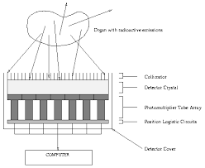
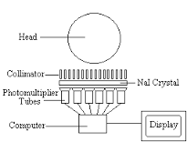
Gamma camera
Gamma camera
Collimator – parallel hole collimator
Detector crystal - NaI
Photomultiplier

Slide 6
Capture of emitted photons by a gamma camera
The event is localized on the basis of where the photon interacts with the crystal

Slide 7
Technical Aspects of Image Acquisition
Myocardial perfusion data is sampled from multiple angles over 360º around the patient
Multiple images, each comprising 20 - 25 s of emission data are collected
Each one of the separate “projection” images constitutes a 2D snapshot of myocardial perfusion from the angle at which the projection was acquired
The imaging information from each of the angles is used to create a 3D reconstruction of the organ of interest

Slide 8
Standard SPECT imaging display
The short-axis images represent a portion of the anterior, lateral, inferior and septal walls
Vertical long-axis images represent the
anterior wall, apex and inferior wall
Horizontal long-axis images represent the septum, apex and lateral walls

Slide 9
Basic properties of myocardial perfusion agents
Perfusion imaging is dependent upon
The physical properties of the radiolabeled tracer
Delivery of the tracer (regional coronary blood flow)
Extraction and retention of the tracer by the myocyte
Both cell membrane integrity and energy utilization are necessary for intracellular extraction and retention of tracer
Retained tracer activity is synonymous with myocyte viability

Slide 10
Basic properties of myocardial perfusion agents
The ideal perfusion agent
High first pass myocardial extraction
Linear relationship between uptake and flow
Uptake independent of metabolic state
Stable distribution during imaging

Slide 11
The relation between myocardial blood flow and perfusion tracer uptake
The ideal perfusion tracer would track myocardial blood flow across the entire range of physiologically relevant flows
The different tracers reach a plateau at different levels of myocardial blood flow

Slide 12
SPECT Perfusion Tracers - Thallium-201
Cyclotron produced -- Requires off-site manufacturing
The principal photo peaks are gamma rays
69 to 83 keV (85 to 90%)
167 keV (10%)
135 keV (2.7%)
T_{1/2} is prolonged (73 hrs)
limits the overall amount that can be administered to 2 to 4 mCi
Monovalent cation with biologic properties similar to those of potassium
First-pass extraction fraction is high (85%)

Slide 13
Thallium-201 - properties
Uptake is partly an active process (Na-K-ATPase pump)
Peak myocardial concentration occurs within 5 minutes of injection
Rapid clearance from the intravascular compartment
Linear relationship between flow and myocardial thallium activity
proportional up to at least twice the resting flow rates

Slide 14
Thallium-201 - properties
Advantages:
Redistribution allows a single injection for both stress and rest images
"gold standard" for viability assessment among single photon agents
Disadvantages:
Low photon energy results in more scatter and soft tissue attenuation
Longer physical half-life limits the allowable dose → reduced image quality

Slide 15
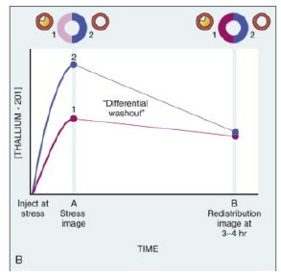
Thallium-201 redistribution
An equilibrium is created between the intracellular and extracellular concentrations of thallium
After blood level diminish the equilibrium favors egress of thallium out of the myocyte
Thallium concentration diminishes more slowly in zones with less initial thallium uptake

Slide 16
Thallium-201 redistribution
Redistribution is unrelated to flow
Rate of thallium clearance from myocardium
Linked to the concentration gradient between myocytes and the blood levels of thallium
Redistribution often begins as early as 20 mins
Post-stress imaging should begin within 15 minutes after the initial injection
Redistribution → assessment of relative regional coronary blood flow following stress and under "resting" conditions, after a single injection of tracer

Slide 17
Assessment of Myocardial Blood Flow at rest
Visualization of myocardial regions suggests the presence of working, viable cell membranes
Lack of visualization of myocardium does not necessarily indicate the absence of viable cells
Infarcted myocardium
Hibernating but viable myocardium
A severe reduction in tracer activity usually signifies infarction

Slide 18
An apical infarction in the HLA and VLA views
An inferior infarction in the SA and VLA views
Severity of the defect suggests minimal myocyte viability within those territories

Slide 19
Effect of Coronary Stenosis on Coronary Blood Flow Reserve

Slide 20
Effect of Coronary Stenosis on Coronary Blood Flow Reserve
Illustration of coronary blood flow reserve abnormalities

Slide 21
Detection of Stress-Induced Ischemia Versus Infarction with Myocardial Perfusion Imaging
SPECT anterior and apical reversible perfusion defects
Irreversible or fixed defects
When both viable myocardium and scarred myocardium are present, reversibility is incomplete (partial reversibility) on the delayed images

Slide 22
Thallium 201 protocols
Stress-redistribution imaging
Was the standard imaging protocol
Single injection at peak stress
47% of segments that have fixed defects at 4 hours show evidence of viability on PET scanning
Tillisch J et al. Reversibility of cardiac wall-motion abnormalities predicted by positron tomography. N Engl J Med 1986

Slide 23
Stress-redistribution imaging
Late redistribution imaging
In some instances, redistribution takes longer than 4 hrs
May be related to relatively lower blood levels of thallium-201 throughout the redistribution period
Redistribution imaging 18 to 24 hrs after thallium-201 injection
20% of fixed defects at 4 hour imaging show late distribution at 24 hrs
Perrone-Filardi P et al. Assessment of myocardial viability in patients with chronic coronary artery disease. Rest-4-hour-24-hour 201Tl tomography versus dobutamine echocardiography. Circulation 1996

Slide 24
Stress-redistribution imaging
95% of segments with late redistribution show improved stress perfusion following revascularization
Disadvantage : poor quality images due to tracer washout and decay
Even with delayed imaging, a proportion of segments with fixed defects improve function after revascularization
some viable segments may never redistribute unless blood levels of thallium-201 are augmented
37 % of fixed defects even after late imaging improved after revascularization
Kiat H et al. Late reversibility of tomographic myocardial thallium-201 defects: an accurate marker of myocardial viability. J Am Coll Cardiol 1988

Slide 25
Thallium-201 reinjection protocol
The reinjection of a second, smaller dose of ²⁰¹Tl
Immediately following the redistribution images
Increases the blood level of ²⁰¹Tl
Enhanced detection of stress defect reversibility
50 to 70 % of fixed defects at 4 hr were proved viable
Positive predictive value - 69%
Negative predictive value - 89 %

Slide 26
Thallium-201 reinjection protocol
“Differential uptake"
Infrequent phenomenon
Segments with reversible defects at redistribution appear to have more severe defects following reinjection
Relatively smaller increment in regional thallium-201 uptake following reinjection in ischemic compared to normal zones
Implication : It is probably necessary to obtain all three image sets (stress, redistribution and reinjection) to optimize assessment of ischemia and viability fully

Slide 27
Rest-redistribution imaging
A significant percentage of resting thallium-201 defects show redistribution when reimaged several hours after injection
Indicative of regional myocardial viability
An increase of tracer uptake of ≥ 10% on the redistribution images is considered indicative of viability
Useful when fixed perfusion defect is seen in dual isotope rest–stress study

Slide 28
Technetium-99 labelled agents
Tc-99m is a generator produced product → readily available (on site) at most institutions
Advantages
Higher photon energy (140 keV)
well suited for gamma camera imaging
less photon attenuation and scatter due to soft tissue
Short half-life (6 hrs) and favorable dosimetry
Permits the administration of substantially more activity → high number of emitted photons and improved image resolution
The increased photon flux permits functional imaging with gated SPECT or first-pass techniques

Slide 29
Sestamibi
Lipophilic monovalent cation with transient hepatic uptake, minimal lung uptake and a good target-to-background ratio
First-pass extraction fraction - 60%
Mechanism of myocardial uptake
Passive across the plasma and mitochondrial membranes
Driven by the transmembrane electrochemical gradient
Retained within the mitochondria

Slide 30
Sestamibi
Advantages:
Simultaneous perfusion and function assessment is possible
Minimal redistribution over time
Well suited to the prolonged acquisition times associated with tomographic imaging
The absence of redistribution
Necessitates two separate injections, one during peak stress and a second while at rest
Permits greater flexibility in scheduling (immediate image acquisition is not required)

Slide 31
Tetrofosmin
A lipophilic, cationic compound
Good myocardial uptake with rapid clearance from the liver, lungs and blood
First-pass extraction fraction - 60%
More rapid washout from the liver than with sestamibi
Permitting earlier imaging after injection
Less artifact from subdiaphragmatic activity

Slide 32
99mTc protocols
Three basic protocols with 99mTc-labeled tracers:
A single-day study
Myocardial blood flow is interrogated at rest and at peak stress
First injected dose is low (8 to 10 mCi) and the second injected dose is high (22 to 30 mCi)
A 2-day study (patients with large body habitus)
Higher doses of the tracer are injected (20 to 30 mCi) both at rest and at peak stress to optimize myocardial count rate
A dual-isotope technique
Injection of thallium at rest followed by injection of a 99mTc tracer at peak stress

Slide 33
Dual isotope study
Thallium rest redistribution and 99mTc Sestamibi stress test

Slide 34
Summary

Slide 35
General Principles of Interpretation and Reporting
The key elements to be reported
Perfusion defects - presence and location
Reversibility (stress induced ischemia)
Irreversible or fixed (MI)
The extent of perfusion abnormality
Severity
Extent and severity
Independent risk factors
Risk stratification
It is not sufficient to describe a stress perfusion imaging test as simply “abnormal”

Slide 36
SPECT Image Interpretation and Reporting Visual evaluation
A, A large, moderately severe, reversible IW defect reflecting a moderately severe flow reserve abnormality
B, A milder reversible IW defect reflecting a less severe stenosis or a severe stenosis with well-developed collaterals minimizing the defect severity
In both patients, there is also a mild lateral wall reversible defect

Slide 37
Single vascular territory reversible defects
A, A reversible IW defect consistent with inducible ischemia in the RCA territory
B, A reversible lateral wall defect consistent with inducible ischemia in the LCX territory
C, A reversible anterior wall defect consistent with inducible ischemia in the LAD territory

Slide 38
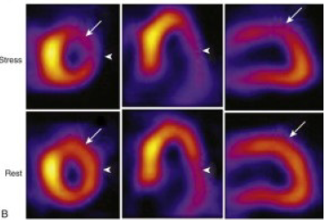
Reversible defects in more than one vascular territory
A, Inducible ischemia in LCX and RCA territories
B, Inducible ischemia in LCX and LAD territories

Slide 39
Perfusion abnormalities in all three major vascular territories

Slide 40
Advantages and Disadvantages of Visual Analysis
Accuracy of visual analysis
Experience and training of the reader
Quality of the imaging study
Advantage
Incorporate information from the raw data (e.g., Breast or an elevated diaphragm attenuating the inferior wall)
Adjust threshold for interpreting an abnormality
Disadvantage
Inherently subjective
Intraobserver and interobserver variability

Slide 41
Semiquantitative visual analysis
A standardised segmentation model
Myocardium is divided into 17 segments
On the basis of 3 short-axis slices and a representative long-axis slice to depict the apex
Perfusion is graded within each segment on a scale of 0 to 4
0: Normal perfusion
4: A very severe perfusion defect

Slide 42
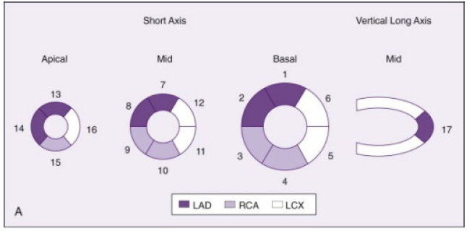
Semiquantitative visual analysis
The segmental scores are assigned
Subjectively by the image interpreter or
Automatically by software programs

Slide 43
Semiquantitative visual analysis
Scores for all 17 segments are added to create a “summed” score
Summed stress score, SSS
Represents the extent and severity of stress perfusion abnormality, (magnitude of perfusion defects related to both ischemia and infarction)
Summed rest score, SRS
Represents the extent of infarction
The summed difference score (SDS)
Subtracting the SRS from the SSS and
Represents the extent and severity of stress-induced ischemia
SSS : Predictors of natural history outcomes

Slide 44
Standard segmental myocardial display for semiquantitative visual analysis in a 17-segment model
Segmental scoring: severe apical fixed defect extending into the inferoapical and anteroapical walls with evidence of reversible defects in the inferior and lateral walls. SSS = 23; SRS = 15; SDS = SSS − SRS = 8 represents the extent of ischemia

Slide 45
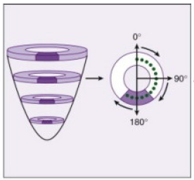
Quantitative analysis of SPECT imaging
Circumferential profile of relative tracer activity
The most common technique employed
Around the tomogram of interest, such as a short-axis tomogram
Each short-axis tomogram is sampled at every 3-6º for 360º, along a ray extending from the center of the image

Slide 46
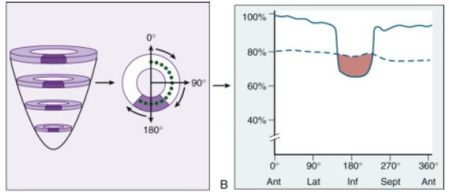
Quantitative analysis of SPECT imaging
The maximum pixel (midportion of the myocardium) are recorded for each angle
The data may be plotted to create a profile of the perfusion pattern relative to the most “normal” area of uptake (assigned a value of 100% uptake)

Slide 47
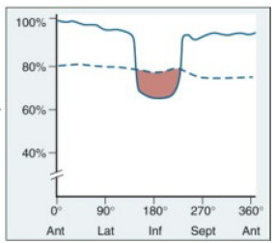
Quantitative analysis of SPECT imaging
Quantitative extent of abnormality
Total amount of myocardium that falls below the lower limit of normal
Severity of the perfusion abnormality
Depth of the patient's perfusion abnormality relative to the lower limit of normal
Lower limit of normal

Slide 48
Bull's-eye polar plot
Data from all of the individual short-axis tomograms can be combined
2D compilation of all of the 3D short-axis perfusion data

Slide 50
Automated quantitative analysis software
Selected short- and long-axis
tomograms from stress and rest studies are automatically segmented and scored
3D
Extent of ischemic myocardium (white area) measures 23% of the total myocardium
BULL’s EYE PLOTS

Slide 51
Advantages and Disadvantages of Quantitative Analysis
Advantages
Little or no human interaction
Highly reproducible
Accounts for potential artifacts such as breast or diaphragm attenuation
More objectivity and reproduciblility → Interrogate the effect of therapies on serial changes in myocardial perfusion
Disadvantages
Artifacts that are not accounted for by the normal data comparison (motion or other suboptimal quality issues may be called abnormal by quantitation)
In practice : Final conclusion is arrived by visual analysis incorporating the quantitative data

Slide 52
Beyond Myocardial Perfusion (Signs in SPECT Imaging Analysis)
Lung Uptake
In some patients, substantial tracer uptake is apparent throughout the lung fields after stress that is not present at rest
Often have severe multivessel disease
Elevation of PCWP during exercise
Decreases in EF during exercise
Mechanism:
Ischemia-induced elevation in LA and pulmonary pressures slows pulmonary transit of the tracer → more time for extraction or transudation into the interstitial spaces of the lung

Slide 53
Increased lung uptake of Thallium 201

Slide 54
Transient Ischemic Dilation of the Left Ventricle
Imaging pattern in which the LV or LV cavity appears larger on the stress images than at rest
Entire left ventricle appears larger during stress
Pathophysiology: Extensive ischemia and prolonged postischemic systolic dysfunction resulting in a dilated, dysfunctional LV
Apparent dilation of the LV cavity
The epicardial silhouette appears similar at stress and rest
Diffuse subendocardial ischemia
Associated with severe and extensive CAD

Slide 55
Transient Ischemic Dilation of the Left Ventricle
Transient ischemic dilation of LV
The perfusion pattern suggests single-vessel disease, but the presence of transient ischemic cavity dilation is suggestive of more extensive and higher risk disease

Slide 56
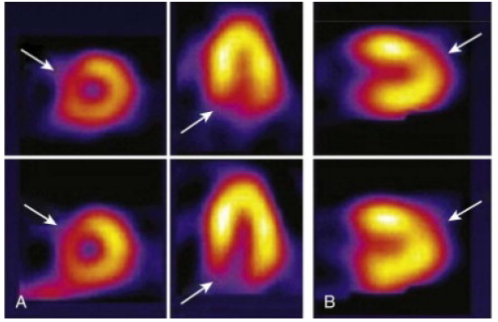
Common Normal Variations in SPECT Imaging
May be falsely interpreted as a defect
Related to structural variations of the myocardium
“dropout” of the upper septum because of merging of the muscular septum with the membranous septum
Apical thinning: The apex is anatomically thinner than other myocardial regions

Slide 57
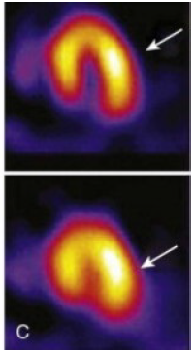
Common Normal Variations in SPECT Imaging
Related to technical factors associated with image acquisition
The lateral wall may often appear brighter than the contralateral septum
The camera is physically closer to the lateral myocardial wall than to the septum → less soft tissue attenuation and more efficient count capture

Slide 58
Technical Artifacts Affecting Image Interpretation
Attenuation of photons refers to undetected events in the heart due to interaction of photons with the intervening soft tissue
Mimic true myocardial perfusion defects → Reduce specificity (increase false-positive findings)
Breast Attenuation
In patients with large or dense breasts, significant attenuation may create artifacts
Gender-matched quantitative data bases have had a favorable impact
Data bases generally consist of subjects of average body and breast size

Slide 59
Technical Artifacts Affecting Image Interpretation
A mild fixed anterior and anteroseptal defect
? A nontransmural anterior infarct
? Artifact due to breast attenuation

Slide 60
Technical Artifacts Affecting Image Interpretation
In the gated images, the same SA and VLA views are frozen in end diastole and end systole
Wall thickening from end diastole to end systole appears normal
This is most consistent with an attenuation artifact

Slide 61
Technical Artifacts Affecting Image Interpretation
Inferior Wall Attenuation
Commonly encountered in SPECT imaging
May be caused by diaphragm overlapping the inferior wall
The longer distance from the IW to the camera → photons must traverse a greater degree of tissue before reaching the detectors → increase the degree of scatter and attenuation

Slide 62
Technical Artifacts Affecting Image Interpretation
Attenuation of the inferior basal wall
Most commonly, this appears as a tapering of the IW seen best on the VLA
Prone position: The IW is pulled somewhat away from the diaphragm

Slide 63
ECG-gated SPECT
Simultaneous assessment of LV function and perfusion
Involves creation of one cardiac cycle for analysis that represents an average of several hundred beats
counts recorded during any individual cardiac cycle is insufficient
Images acquired during a period of 8 to 15 minutes
Frames are redisplayed sequentially in a cine or movie format
Beat-length windowing
High-quality ECG-gated images

Slide 64
Basis for the technique of ECG gating
1 – end diastolic
4 – end systolic
Wall thickening and brightening are seen across the course of systole

Slide 65
ECG-gated SPECT image interpretation
Visual assessment of regional myocardial function
Normally brightening - normal regional systolic performance
Diminished but apparent brightening – hypokinetic
Slight brightening - severely hypokinetic
No apparent brightening - akinetic

Slide 66
ECG-gated SPECT – Visual assessment
A, Inferior region appears to brighten less - severely hypokinetic
The lateral wall also brightens less than the normal septum - hypokinetic
B, The apex in HLA appears to have no change from diastole to systole - Akinetic

Slide 67
ECG-gated SPECT - Quantitative Analysis
Computer-based methodology with software capable of quantitative analysis
Fully automated and highly reproducible
Automated interrogation of the apparent epicardial and endocardial borders of all of the tomograms in all three orthogonal planes
These multiple 2D contours are then reconstructed to create a surface-rendered 3D display
Can be viewed from any direction by simple maneuvering
Automated calculation of EF and LV volumes

Slide 68
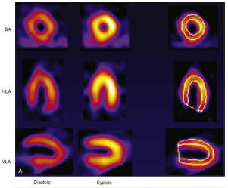
ECG-gated SPECT - Quantitative Analysis
The green “mesh” represents the epicardium, and the gray surface represents the endocardium
EF is quantitated from the volume change
During image interpretation, gated SPECT images are displayed in the cine format as an endless loop movie

Slide 69
Radionuclide Ventriculography (radionuclide angiography or blood pool imaging)
Performed by first-pass or by equilibrium gated techniques (MUGA scanning)
The two techniques use distinct tracers and data recording
Provide similar results for global EF and chamber volumes
Highly reproducible to quantify global LV and RV EF
Equilibrium Radionuclide Ventriculography (Gated Blood Pool Imaging)
Data are recorded in a computer system synchronized with the R wave of the patient's ECG (similar to ECG-gated SPECT)
For labeling of the blood pool, 99mTc is bound to RBC (better image contrast) or albumin

Slide 70
Equilibrium Radionuclide Ventriculography
Image Acquisition
Summation of counts from 800 to 1000 cardiac cycles
Images are usually acquired in three standard projections:
Anterior, “best septal” LAO and left lateral
Minimum framing rate
Resting RVG study : 16 frames/cycle (about 50 msec/frame)
Quantitative assessment of diastolic indices and regional EF : 32 frames/cycle (about 25 msec/frame)
Images are acquired for a preset count of at least 250,000 per frame or count density of 300 counts per pixel, which corresponds to an acquisition time of 5 to 10 minutes per projection

Slide 71
RVG - Image Display and Analysis Qualitative analysis
Qualitative inspection as an endless cinematic loop of the cardiac cycle
Size of heart chambers and great vessels
Regional wall motion
Global function (qualitative assessment)
Extracardiac uptake (such as splenomegaly)

Slide 72
ECG-gated equilibrium RVG schematic images

Slide 73
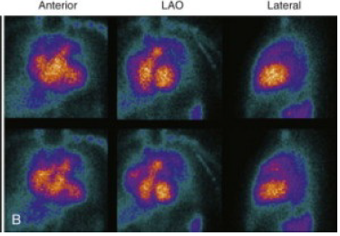
RVG - Image Display and Analysis Qualitative analysis
Normal LV function
LV and RV volumes diminish from diastole
to systole
LV dysfunction
Much less volume change from end diastole to end systole

Slide 74
RVG - Image Display and Analysis Quantitative analysis
The LAO view of the LV and RV at end diastole with a region of interest (ROI) identifying the LV contour
“background” ROI drawn at end systole, used to correct for count activity in front of and behind the LV

Slide 75
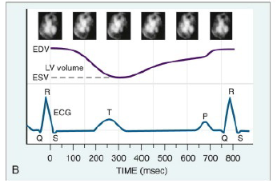
RVG - Image Display and Analysis Quantitative analysis
Time-activity curve
The change in counts within the ROI across a cardiac cycle
Count activity is related to LV chamber volume
The time-activity curve represents the relative volume change of the LV chamber across a cardiac cycle

Slide 76
First-Pass Radionuclide Angiography or Ventriculography
The bolus of radioactivity passes initially through the right chambers of the heart → lungs → left sided chambers of the heart
Tracers used must produce adequate counts in a short time at an acceptably low radiation dose
99mTc-DTPA is the recommended radionuclide of choice

Slide 77
First-Pass RVG
Image Acquisition
Images are acquired very rapidly as the tracer passes through
Separation of the RV and LV is achieved because of the temporal separation of the bolus
Image quality is related to the injection technique (requires rapid (2 - 3 s) uninterrupted bolus)
Images are acquired in the supine position after the rapid injection of 25 mCi of tracer
Medial antecubital or external jugular vein
The shallow (20-30º) RAO projection is used to optimize separation of the atria and great vessels from the ventricles

Slide 78
First-pass radionuclide ventriculography
Individual frames from a first-pass acquisition
Path of the bolus isotope through the SVC, RA, RV, RVOT and lungs (PA), LA and LV

Slide 79
First-pass radionuclide ventriculography
Image Analysis
To identify the RV and LV phases, regions of interest are drawn around the right and left ventricles at end diastole
Time-activity curves are generated and cycles around the peak time-activity curve are used to calculate Efs
In general, 2-5 cardiac cycles are summed for the RV phase and 5-7 cycles are summed for the LV phase
From these data, quantitative analysis of LVEF and RVEF is performed

Slide 80
Comparison of Equilibrium and First-Pass Techniques
Advantages of the first-pass technique
High target-to-background ratio
Rapidity of imaging
More distinct temporal separation of the cardiac chambers
RVEF may be more readily assessed
Advantages of equilibrium technique
Potential for repeated assessment during rapidly varying physiologic conditions
High count density
Acquisition of images in multiple projections
In contemporary practice, the equilibrium technique is performed far more commonly

Slide 81
Positron emission tomography
Beta decay
Electron capture
Positron emission
Electron emission
Measurement of myocardial perfusion and metabolism in absolute quantitative terms
ml/g/minute for blood flow
moles/gram/minute for metabolism

Slide 82
PET - Image Acquisition
Schematic of positron and electron beta particle emission, with detection by a coincidence camera

Slide 83
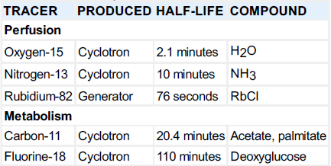
PET Tracers
PET imaging is based on two concepts:
Myocardial flow and myocardial metabolism

Slide 84
PET – Tracers
Ischemic myocardium : fatty acids → glucose
Uptake of FDG in an area of dysfunctional myocardium indicates metabolic activity and thus viability
Regional perfusion can be simultaneously assessed with N-13 ammonia or Rb-82

Slide 85
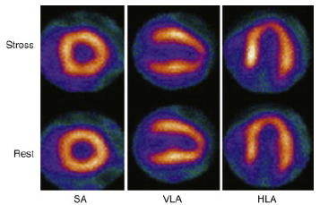
PET - Image Analysis
Emission data are displayed as tomograms similar to SPECT display (SA, HLA, VLA)

Slide 86
PET - Image Analysis
Differentiation of normal, stunned, hibernating and necrotic myocardium
Hibernating myocardium
Presence of enhanced FDG uptake in regions of decreased blood flow ("PET mismatch")
Necrotic myocardium
Concordant reduction in both metabolism and flow ("PET match")
Stunning
Regional dysfunction in presence of normal perfusion

Slide 87
Clinical Application of PET Perfusion Imaging
Segments with reductions in both blood flow and FDG uptake
Only a 20% chance of functional improvement following revascularization
Hibernating segments
80 to 85% chance of functional improvement following revascularization
The PPV and NPV for improvement in wall motion score after revascularization is 96%
Extent of myocardium with enhanced FDG uptake predicts the magnitude of improvement in EF, exercise tolerance and HF symptoms

Slide 88
Hybernating myocardium
Scarred in anteroseptal region

Slide 89
Advantages of PET over SPECT
Higher spatial resolution
Improved attenuation and scatter correction
Sensitivity and specificity (95%) for detection of CAD
"probably normal" or abnormal studies by SPECT versus PET (37 vs 21 %)
Quantification of myocardial blood flow in absolute terms
“balanced” ischemia may not be detected by SPECT

Slide 90
Limitations
Requirement of an on-site cyclotron for [13N]ammonia
High cost of monthly generator replacement for 82Rb
Relatively short half-lives of both 82Rb and [13N]ammonia limit the utility of PET to patients undergoing pharmacologic stress only

Slide 91
Comparison with non-nuclear techniques
Dobutamine echocardiography is an established technique for viability detection
Relative predictive value of the different forms of radionuclide MPI and of dobutamine echocardiography
Meta-analysis : 52 studies; 1367 patients with ischemic LV dysfunction
For each technique, NPV > PPV
NPV: Highest with FDG-PET, reinjection thallium SPECT and dobutamine echocardiography
PPV : Highest with dobutamine echocardiography and lowest with reinjection thallium SPECT
Bax JJ et al. Sensitivity, specificity, and predictive accuracies of various noninvasive techniques for detecting hibernating myocardium. Curr Probl Cardiol 2001

Slide 92
Predictive accuracy of imaging tests for myocardial viability

Slide 93
Assessment of myocardial viability by nuclear imaging in CAD
Why viability assessment?
CAD is the major cause of HF
Severe LV dysfunction – not an irreversible condition
Hibernation and stunning are potentially reversible
Viable myocardium can be demonstrated in 20-40% of patients with CAD and LV dysfunction, even in the absence of angina
Allman KC et al. Myocardial viability testing and impact of revascularization on prognosis in patients with coronary artery disease and left ventricular dysfunction: a meta-analysis. J Am Coll Cardiol 2002

Slide 94
Assessment of myocardial viability by nuclear imaging in CAD
The outcome depends not only on the presence, but also the extent of viability
Group A - > 7 viable segments
Group B - ≤ 7 viable segments

Slide 95
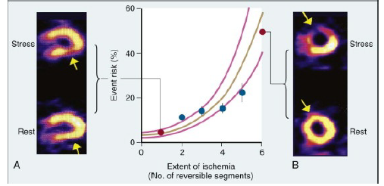
Risk Stratification in Stable Chest Pain Syndromes
The Relation Between the Extent of Perfusion Defect and Natural History Outcomes

Slide 96
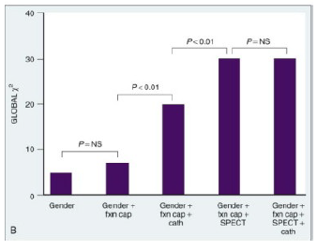
The Incremental Value of Perfusion Imaging
The larger the chi-square value, the stronger the relation between the combination of factors on the x-axis and the natural history outcome
Even when anatomic information is available, the physiologic information provided by SPECT MPI adds significantly to risk prediction ability

Slide 97
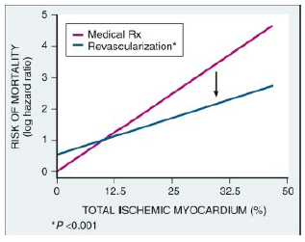
Identification of Treatment Benefit After Risk Stratification
Stress MPI in >10,000 patients with suspected CAD
The extent of ischemic myocardium predicted reduction in the risk of death with revascularization
Just over 10% of ischemic myocardium
As the percentage of ischemic myocardium increased, the magnitude of benefit of revascularization increased as well

Slide 98
Prognostic Value of Normal MPI
Studies → Benign outcome associated with a normal stress MPI study
ACC/AHA/ASNC Radionuclide Imaging Guidelines
Data of 21,000 patients with normal stress SPECT MPI study
The hard event rate is 0.7% / yr (follow-up of 2 yrs - “warranty period”)
Baseline high risk factors (e.g., DM) → slightly higher risk after a normal stress MPI study (consistent with Bayes’ theorem)
Angiographic CAD with a stable symptom complex
Low-risk outcome (~0.9% / yr) with a normal stress MPI
The mechanism: ? Preserved endothelial function despite CAD allowing appropriate flow-mediated vasodilation during stress

Slide 99
Influence of Perfusion Tracer on Detection of CAD
The choice of radiotracer → does not notably affect the discrimination between the presence and absence of CAD
Studies comparing the widely used agents →No significant improvement in sensitivity or specificity
Exception: Demonstration of improved specificity in women with 99mTc-sestamibi
99mTc-based agents (greater photon energy)
Improved performance in obese patients and those with large breasts
Higher quality gated images

Slide 100
Pharmacologic Stress Testing for Detection of CAD
Vasodilator stress (more powerful hyperemic stress response)
No improved sensitivity to detect CAD
Because of the “roll-off” property of the common perfusion tracers (diffusion limitation at high flow levels)
2003 ACC/AHA/ASNC Radionuclide Imaging Guidelines
Pooled analysis of 2465 catheterized patients in 17 studies
Sensitivity of 89% and specificity of 75% (similar to exercise SPECT MPI)
Dobutamine stress imaging
Diagnostic ability : Similar to other pharmacologic and exercise stress
Recommended only when other agents are contraindicated
Maximal coronary flow reserve is not achieved often
Substantial side effects

Slide 101
Effect of Submaximal Exercise Performance on CAD Detection
In exercise ECG testing, sensitivity falls significantly if >85% of maximum predicted HR for age is not achieved
Perfusion heterogeneity usually develops at a lower degree of supply-demand mismatch than ECG changes
Sensitivity of MPI is maintained at somewhat lower workloads
No difference in sensitivity between the maximal and the submaximal tests
The extent and severity of reversible perfusion defects are diminished at submaximal workloads, which may affect the prognostic value of the test

Slide 102
Detecting and Defining the Extent of CAD
To formulate a management strategy → Extent of disease >> presence or absence of disease
SPECT MPI is limited by the relative nature of the perfusion information
In TVD with balanced ischemia, the least hypoperfused area appears normal → true extent of CAD may be underestimated
Gated SPECT allows improved sensitivity (85% to 91%)
Sharir T, Bacher-Stier C, Dhar S, et al: Identification of severe and extensive CAD by postexercise regional wall motion abnormalities in Tc-99m sestamibi gated SPECT. Am J Cardiol 2000

Slide 103
Detection of CAD in Women
The detection of CAD by exercise ECG testing is problematic in women
201Tl → limited by problems associated with breast attenuation
With the incorporation of gated SPECT sestamibi imaging, specificity - 92% (67% with 201Tl)

Slide 104
Imaging in Patients with Established CAD
Clinical questions may remain after angiography regarding the “physiologic significance” of stenoses
SPECT MPI can identify the “culprit” ischemic lesion
The results of stress-rest SPECT MPI correlate generally with invasive measures of coronary flow reserve
Successful PCI → Improvement of SPECT evidence of ischemia

Slide 105
Imaging After CABG
Recurrent symptoms post CABG: SPECT MPI accurately detects graft stenoses
Routine assessment for ischemia in an asymptomatic patient is not recommended (outcome risk is low in the early years after CABG)
900 asymptomatic patients post CABG
Defects were common with SPECT MPI
Associated with significantly increased relative risk of death or major events
Ficaro EP American Society of Nuclear Cardiology: Imaging Guidelines for Nuclear Cardiology Procedures

Slide 106
In symptomatic post-CABG patients : Helps to guide the need for intervention
In asymptomatic patients
Implications for clinical decision making are less clear
Extent of SPECT abnormality is important
More extensive perfusion abnormality may justify an invasive approach

Slide 107
Suspected ACS in the Emergency Department
Patients with symptoms suggestive of ACS but with nondiagnostic ECG and biomarker
99mTc-based perfusion agents may be administered in the ED at rest, with images acquired 45 to 60 minutes later
Images reflect myocardial blood flow at the time of injection (minimal redistribution)
NPV for ruling out MI is high
Positive MPI → higher risk of cardiac events during the index hospitalization as well as during follow-up
Assist triage decisions

Slide 108
Suspected ACS in the Emergency Department
Sensitivity to detect ACS in the ED
SPECT sestamibi - 92%
Initial troponin I (drawn at the same time) - 39%
The maximum troponin I during the first 24 hrs had a sensitivity similar to that of rest sestamibi imaging but at a distinctly later time point
Acute MPI has the potential to identify ACS earlier than biomarkers
One RCT of 46 ED patients with ongoing chest pain and a nondiagnostic ECG
MPI-guided strategy incurred lower costs and resulted in shorter lengths of stay
Stowers SA et al: An economic analysis of an aggressive diagnostic strategy with SPECT MPI and early exercise stress testing in ED patients who present with chest pain but nondiagnostic ECGs: Results from a randomized trial. Ann Emerg Med 2000

Slide 109
The Emergency Room Assessment of Sestamibi for Evaluation of chest pain trial (ERASE)
2475 patients with symptoms suggestive of ACS
Significant 20% relative reduction in unnecessary admissions with incorporation of MPI into the ED evaluation strategy
The ACC/AHA/ASNC Radionuclide Imaging Guidelines classify MPI in this setting as a Class I, Level A indication

Slide 110
NSTEMI and UA
High-risk stress-rest SPECT MPI
Despite medical stabilisation, requires intervention
Normal SPECT MPI
Summary of predictive values of SPECT imaging in the aftermath of UA from multiple studies
SPECT perfusion imaging in patients after medical stabilization of unstable angina

Slide 111
Assessment of Inducible Ischemia after MI
Three major determinants of natural history risk after an acute MI
Residual resting LV function
Extent of ischemic, jeopardized myocardium
Susceptibility to ventricular arrhythmias
Gated SPECT MPI
Has the ability to provide much of this information
Has the potential to be the single most important test in the stable patient after STEMI
A “low-risk” 201Tl image (no reversible defects and no lung uptake) was associated with a low-risk natural history outcome after MI
Beller GA:Clinical value of MPI in CAD. J Nucl Cardiol 2003

Slide 112
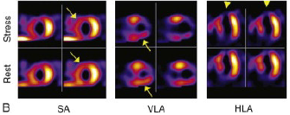
Risk of cardiac event post MI is predicted by the combination of infarct size (represented by LVEF) and the extent of reversible ischemia
Fixed defect (MI) in the anterior wall and apex Extensive inducible ischemia involving 25% of the ventricle
Gated SPECT LVEF was 38%
25% risk of post-MI adverse event

Slide 113
Clinical implications of viability assessment
Two RCTs comparing mechanical revascularization and OMT based on viability have been reported
Both studies reported a lack of association between the presence or absence of residual myocardial viability, treatment allocation and patient outcome
STICH substudy
601 patients - viability assessed by SPECT imaging
No difference in outcome based on the interaction between treatment allocation and the presence or absence of viability

Slide 114
The Canadian PARR study
Randomized 430 patients with severe LV dysfunction
FDG PET
At one year, the cumulative proportion of patients who experienced the primary endpoint (composite of CD, MI or hospitalization for cardiac cause) was no different between groups

Slide 115
The practical implication
OMT and coronary revascularization may be equally efficacious in the vast majority of patients
It is reasonable to revascularize patients with LV systolic dysfunction and CAD with good coronary target vessels and relatively low surgical risk
For the patient at relatively high surgical risk the demonstration of significant residual myocardial viability may make the risk-benefit ratio more favorable for surgery

Slide 116
- Thank you

